Slide 1
Database Fundamentals
Lecturer: Salma Mamdouh
smamdouh@mcit.gov.eg
Room:3005
Made by:
Shahinaz S. Azab
Edited by:
Mona Saleh
Notes:
http://www.youtube.com/watch?v=IzbCLooj-M8

Slide 2
Objective
This course is designed to introduce the fundamentals of
Databases. The students will develop skills in the design,
construction, modification, and use of databases. Structured Query
Language (SQL) will be emphasized.
References
Ramez Elmasri, Fundamentals of Database Systems
C. J. Date: An Introduction to Database Systems,

Slide 3
Grading System
Assignments and Lab Work 40%
Final Exam 60%

Slide 4
Chapter 1 : Introduction
After Completing this chapter, you should be able to do the following:
Define Database, Database System
Identify the Database Properties
Define DBMS
Functions of DBMS
Advantages and Disadvantages of Database
Systems

Slide 5
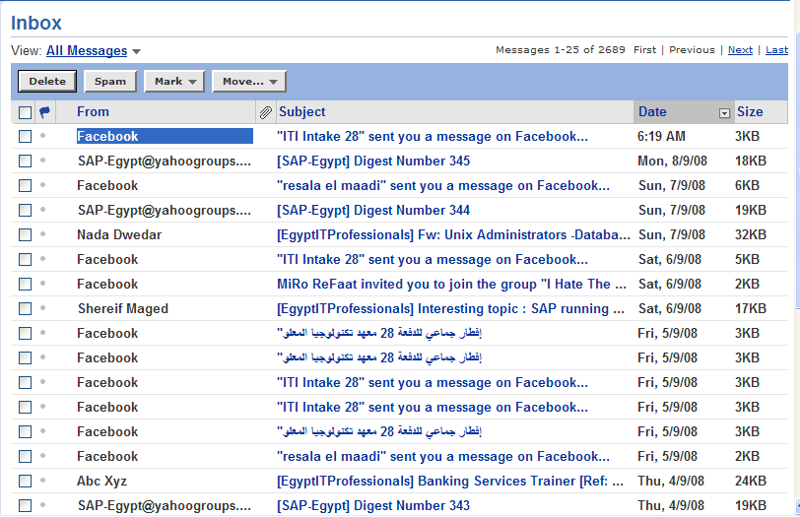
Example

Slide 6
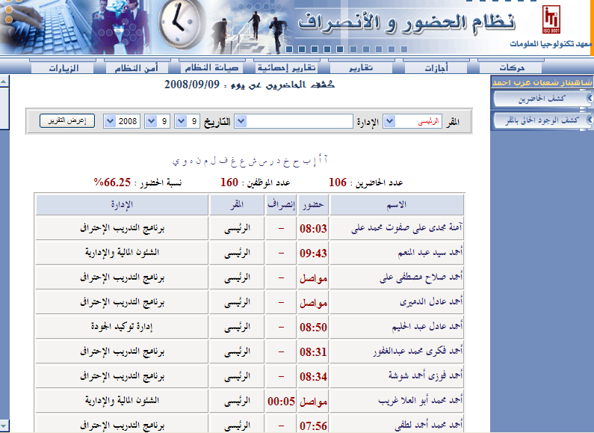

Example

Slide 7
File Based System
It is a collection of programs that perform services for the end user.
Each Program defines and manages its own data

Slide 8
Limitations Of File based System Approach
Separation & Isolation Of data
Duplication Of data
Program Data Dependence
Incompatible File Formats

Slide 9
Basic Definitions
Database: A collection of related data.
Database Management System (DBMS): A software package/ system to facilitate the creation and maintenance of a computerized database.
Database System: The DBMS software together with the data itself. Sometimes, the applications are also included. ( Software + Database )

Slide 10
Database Management System (DBMS)
Users
Database System
Application Programs
DBMS Software
Software to process
Queries
Software to access Stored Data
Stored DB
Definition
(Metadata)
Stored
Database
Notes:
DBMS is a collection of programs that enables users to create and maintain a database. The DBMS is a software system that facilitates the process of defining, constructing, and manipulating databases for various applications. Defining a database involves specifying the data types, and constraints for the data to be stored in the database. Constructing the database is the process of storing the data itself on some storage medium. Manipulating a database includes such functions as querying the database to retrieve, update, delete specific data.
What are the other functions of DBMS ?
Data Security & Integrity , Concurrency , Recovery, Performance , Data Dictionary

Slide 11
DBMS Advantages
Controlling Redundancy.
Restricting Unauthorized Access.
Sharing data.
Enforcing Integrity Constraints
Inconsistency can be avoided.
Providing Backup and Recovery.

Slide 12
DBMS Disadvantages
Needs expertise to use
DBMS is expensive
May be incompatible with any other available DBMS

Slide 13
Database Users
Database Administrator (DBA)
System Analysts
Database Designer
Application programmers
End users

Slide 14
DBMS Architecture
External Schema 1
External Schema 2
External Schema 3
Conceptual Schema
Physical Schema
Levels of Abstraction in a DBMS
(Three Schema Architecture)
Disk

Slide 15
Three Level/Schema Architecture
External – What the user sees: focus on what different types of users will see when viewing the database. They are concerned with what data the user will see and how the data will be presented to the user.
Conceptual – The logical model: focus on the logical nature of the data representation. They are concerned with what is represented rather than how it is represented.(define database structures such as tables and constraints)
Internal – The physical model: place the emphasis on how the data are represented in the database or on how the data structures are implemented.
Notes:
Database Model: a collection of logical constructs used to represent the data structure and the data relationships found within the database.
User models focus on what different types of users will see when viewing the database. They are concerned with what data the user will see and how the data will be presented to the user.
Logical models focus on the logical nature of the data representation. They are concerned with what is represented rather than how it is represented.
Physical models place the emphasis on how the data are represented in the database or on how the data structures are implemented.
External – What the user sees: deals with methods through which users may access the schema, such as through the use of a data input form. The external model allows relationships to be created between the user application and the data model.
Conceptual – The logical model: is the basic database model, which deals with organizational structures that are used to define database structures such as tables and constraints.
Internal – The physical model: deals with the physical storage of the database, as well as access to the data, such as through data storage in tables and the use of indexes to expedite data access. The internal model separates the physical requirements of the hardware and the operating system from the data model.

Slide 16
Data Independence
The capacity to change the schema at one level without having to change the schema at the next higher level
Notes:
Two Types of data Independence:
Logical Data Independence
Physical Data Independence: The capacity to change the internal schema without having to change the conceptual schema.

Slide 17
Data Models
High Level or Conceptual data models provide concepts that are close to the way many users perceive data, entities, attributes and relationships. (Ex. ERD)
Physical data models describes how data is stored in the computer and the access path needed to access and search for data.

